Slide 1
Non-linear Minimization
Fish 559; Lecture 5
Notes:
a

Slide 2




Introduction
Non-linear minimization (or optimization) is the numerical technique that is used by far most frequently in fisheries assessments.
The problem:
  Find the vector so that the function is minimized (note: maximizing is the same as minimizing ).
  We may place bounds on the values for some of the elements of (e.g. some must be positive).

Slide 3
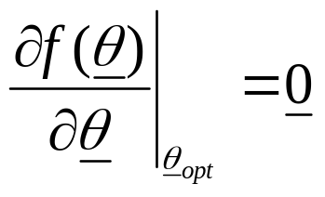
Minimizing a Function-I
By definition, for a minimum:
This problem statement is deceptively simple. There is no perfect algorithm. The art of non-linear minimization is to know which method to use and how to determine whether your chosen method has converged to the correct solution.

Slide 4
Minimizing a Function-II
There are many techniques to find the minimum (maximum) of a function depending on:
  the cost of evaluating the function;
  the cost of programming;
  the cost of storing intermediate results;
  whether analytical or numerical derivatives are available;
  whether bounds are placed on some of the parameters.

Slide 5
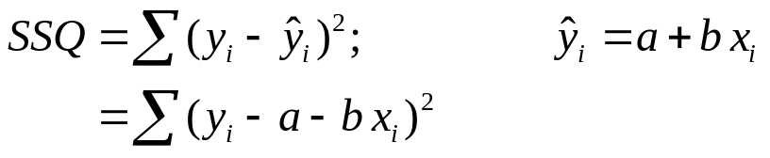
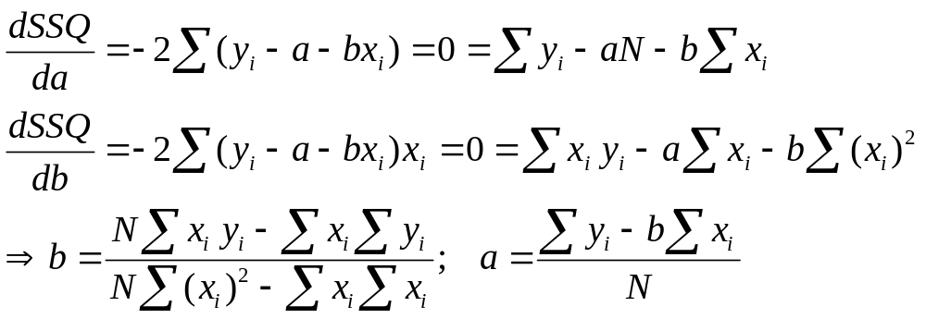
Analytic Approaches-I
Sometimes it is possible to solve the differential equation directly. For example:
Now:

Slide 6
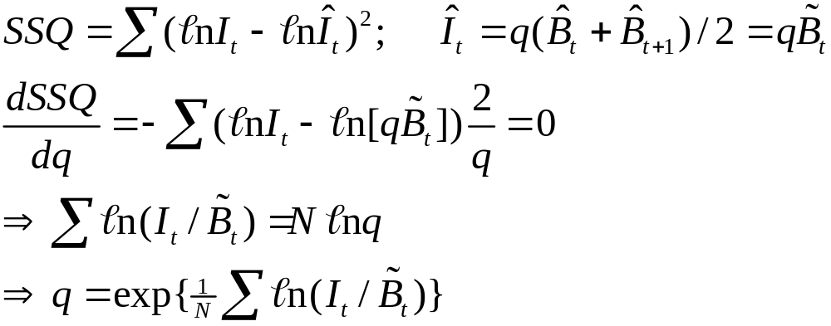
Analytical Approaches-II
Use analytical approaches whenever possible. Finding analytical solutions for some of the parameters of a complicated model can substantially speed up the process of minimizing the function.
For example: q for the Dynamic Schaefer model:

Slide 7
Analytic Approaches-III
The “analytical approach” runs into two main problems:
  The differentiation is very complicated for typical fisheries models.
  The resultant equations may not have an analytical solution, e.g:
We need to find a way to minimize a function numerically.

Slide 8
Newton’s Method - I
(Single variable version)
We wish to find the value of x such that f(x) is at a minimum.
Guess a value for x
Determine whether increasing or decreasing x will lead to a lower value for f(x) (based on the derivative).
Assess the slope and its change (first and second derivatives of f) to determine how far to move from the current value of x.
Change x based on step 3.
Repeat steps 2-4 until no further progress is made.

Slide 9
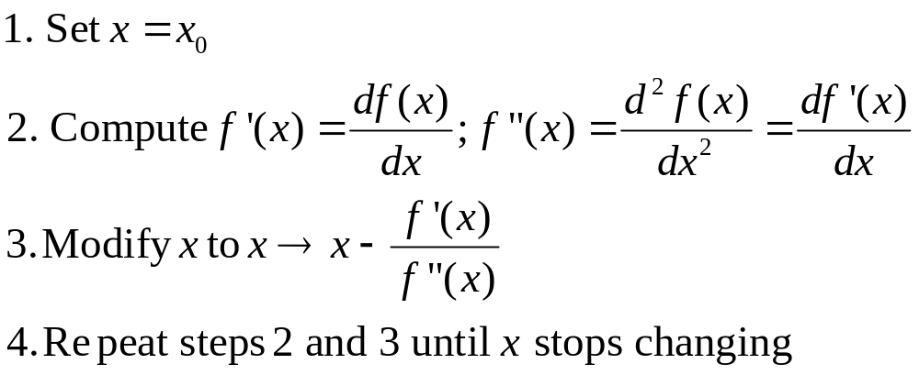
Newton’s Method - II
(Single variable version)
Formally:
Note: Newton’s method may diverge rather than converge!

Slide 10
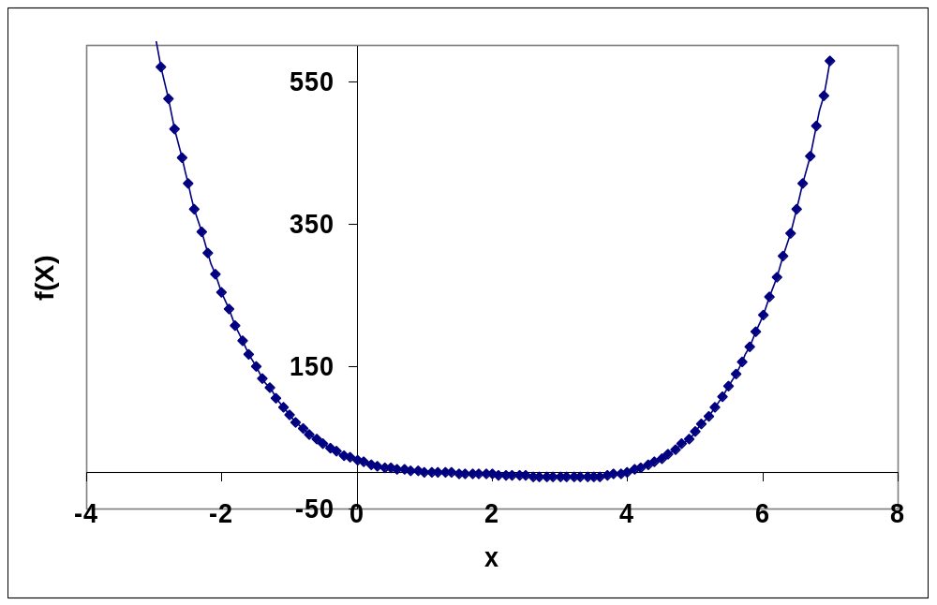
Minimize: 2+(x-2)^4-x^2
This is actually quite
a nasty function –
differentiate it and see!
Minimum: -6.175 at x = 3.165
Convergence took 17 steps in this case.

Slide 11
Multidimensional methods
We will focus on multidimensional methods because most fisheries problems are (highly) multidimensional.
Derivative free:
  Nelder-Mead (Simplex); and
  Direction-set methods (Powell’s method).
Derivatives required:
  Conjugate gradient methods (Fletcher’s method); and
  Quasi-Newton methods.
There is usually no reason not to use derivative-based methods if you can compute derivatives (cheaply).
The focus of this lecture will be on the derivative-free methods.

Slide 12
The Simplex Method-I
Slow and robust, this method “crawls” (amoeba-like) towards the solution. It requires no derivatives and can deal with bounded parameters.

Slide 13
The Simplex Method-II
(an overview)
Set up a “simplex” (a set of N+1 points, where N is the dimension of the parameter vector) and evaluate f at each vertex.
Find the point that has the highest value of f (the worst point) and examine a point reflected away from this point.
If the new point is better than the best point then try again in the same direction.

Slide 14
The Simplex Method-III
(an overview)
If the reflected point is worse than the second worst point:
  replace the worst point if the reflected point is better than the worst point;
  contract back away from the reflected point;
  if the contracted point is better than the highest point replace the highest point; and
  if the contracted point is worse that the worst point contract towards the best point.
Replace the worst point by the reflected point.
Repeat steps 2-5 until the algorithm converges.

Slide 15
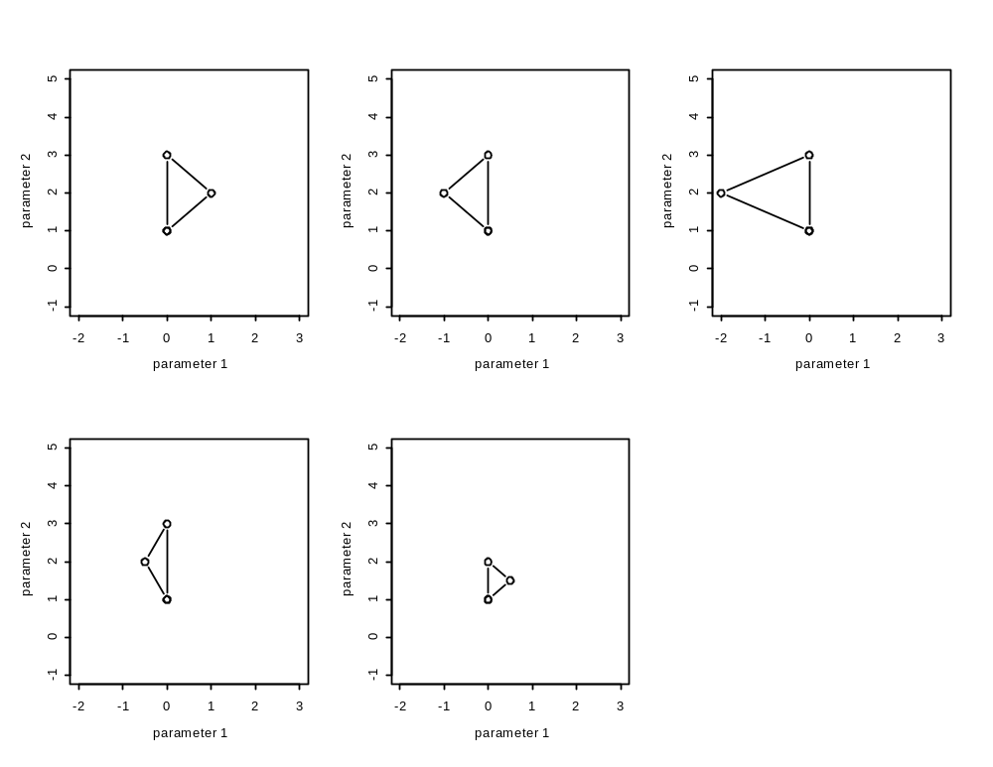
The Simplex Method-IV
(N=2)
Reflect
further
Worst point
Reflect
Best
point
Current
simplex
Contract
Contract about
best point

Slide 16
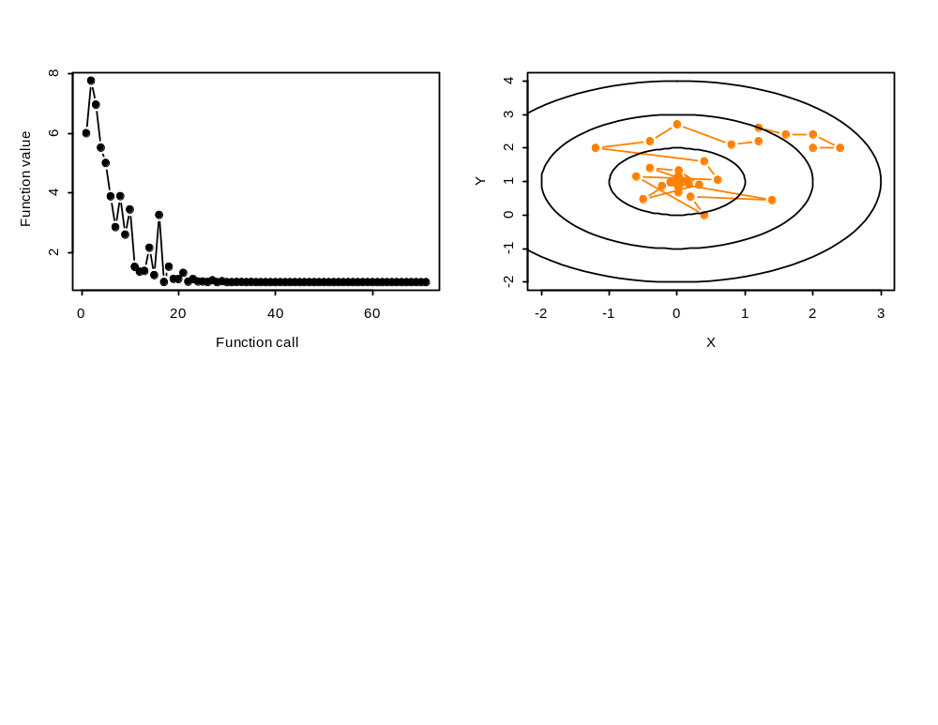
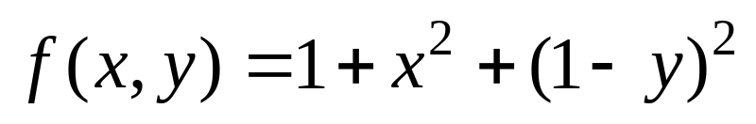
An Example of the Simplex Method-I
Minimize:

Slide 17
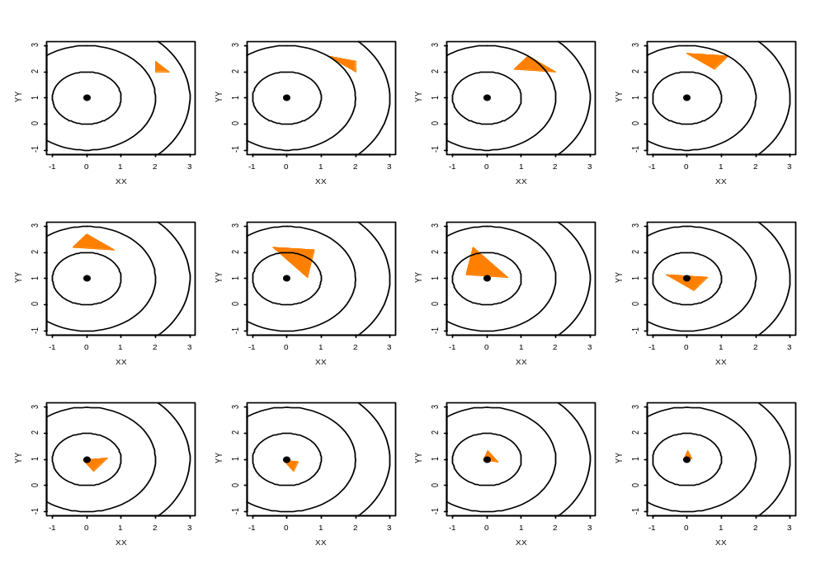
An Example of the Simplex Method-II

Slide 18
Direction Sets
(The Basic Idea-I)
Select a starting point, P₀ (in N dimensions) and set i=0.
Minimize f in each of N search directions, u_{j} (e.g. the unit vectors – this is a single dimensional search). The function value at the end of each search is P_{i,j.}. Note: P_{i+1}=P_{i,N}.
Set u_{j-1}=u_{j} and u_{N}=P_{i+1}-P_{i}.
Repeat steps 2-3 until the algorithm converges.

Slide 19
Direction Sets
(The Basic Idea-II)
Advantages:
  Replaces a multi-dimensional search by a set of single-dimensional searches.
Disadvantages:
  Without step 3, the algorithm is very slow.
  With step 3, the algorithm can fail to converge.
These problems are solved by Powell’s method.

Slide 20
Powell’s Method
(Steepness decent)
Select a starting point, P₀ (in N dimensions) and set i=0.
Minimize f in each of N search directions. The function value at the end of each search is P_{i,j.}. Note: P_{i+1}=P_{i,N}.
Set P_{e}=(2P_{i,N}-P_{i}) and compute f(P_{e}).
If f(P_{e}) > f(P_{i}) then replace the search direction of maximum change to P_{i+1}-P_{i}.
Repeat steps 2-4 until the algorithm converges.

Slide 21
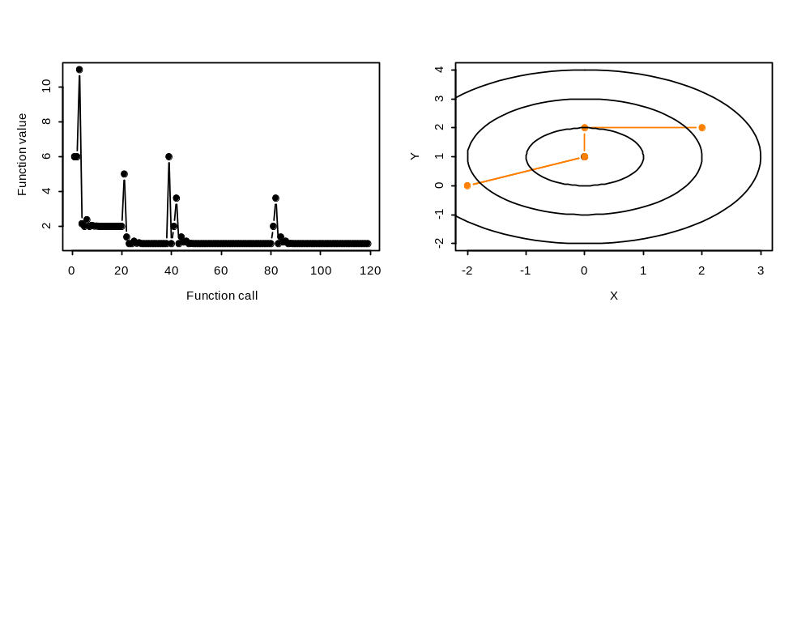
An Example of the Powell’s Method
Minimize:

Slide 22

Using Derivatives
(Steepest Descent Methods)
Select a starting point, P₀ (in N dimensions) and set i=0.
Compute the local downhill gradient, ,at P_{i},
Minimize f from P_{i} along this direction.
Repeat steps 2-3 until the algorithm converges.
This method can, however, be very slow for problems with long narrow valleys.
This method combines line minimization and the use of derivatives.

Slide 23

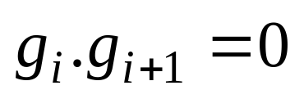
Using Derivatives
(Conjugate gradient methods)
At each step in the previous algorithm, we would prefer to try a direction that is conjugate to the previous direction, i.e. if the direction at step i then .
We won’t provide the formulae to achieve this, but google them!
To apply this type of algorithm you need the ability to compute the gradient and to perform line minimization.

Slide 24
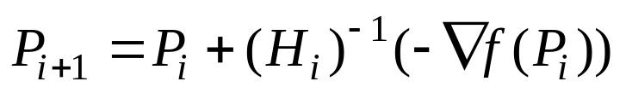
Using Derivatives
(Variable metric methods)
The basic result that drives these methods is where H is the Hessian matrix. In one dimension, this is just Newton’s method that we saw earlier.
Computing the Hessian matrix can be very demanding computationally so variable metric methods approximate it numerically.

